Slide 1
Depth-First Search
Presentation for use with the textbook Data Structures and Algorithms in Java, 6th edition, by M. T. Goodrich, R. Tamassia, and M. H. Goldwasser, Wiley, 2014
A
B
D
E
C

Slide 2
Subgraphs
A subgraph S of a graph G is a graph such that
The vertices of S are a subset of the vertices of G
The edges of S are a subset of the edges of G
A spanning subgraph of G is a subgraph that contains all the vertices of G
Subgraph
Spanning subgraph

Slide 3
Connectivity
A graph is connected if there is a path between every pair of vertices
A connected component of a graph G is a maximal connected subgraph of G
Connected graph
Non connected graph with two connected components

Slide 4
Trees and Forests
A (free) tree is an undirected graph T such that
T is connected
T has no cycles
This definition of tree is different from the one of a rooted tree
A forest is an undirected graph without cycles
The connected components of a forest are trees
Tree
Forest

Slide 5
Spanning Trees and Forests
A spanning tree of a connected graph is a spanning subgraph that is a tree
A spanning tree is not unique unless the graph is a tree
Spanning trees have applications to the design of communication networks
A spanning forest of a graph is a spanning subgraph that is a forest
Graph
Spanning tree

Slide 6
Depth-First Search
Depth-first search (DFS) is a general technique for traversing a graph
A DFS traversal of a graph G
Visits all the vertices and edges of G
Determines whether G is connected
Computes the connected components of G
Computes a spanning forest of G
DFS on a graph with n vertices and m edges takes O(n + m ) time
DFS can be further extended to solve other graph problems
Find and report a path between two given vertices
Find a cycle in the graph
Depth-first search is to graphs what Euler tour is to binary trees

Slide 7
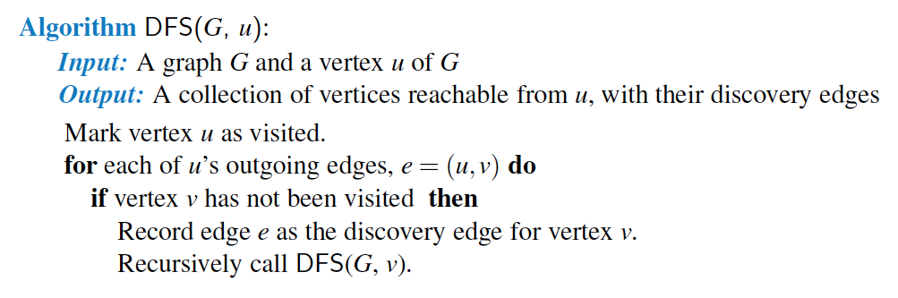
DFS Algorithm from a Vertex

Slide 8
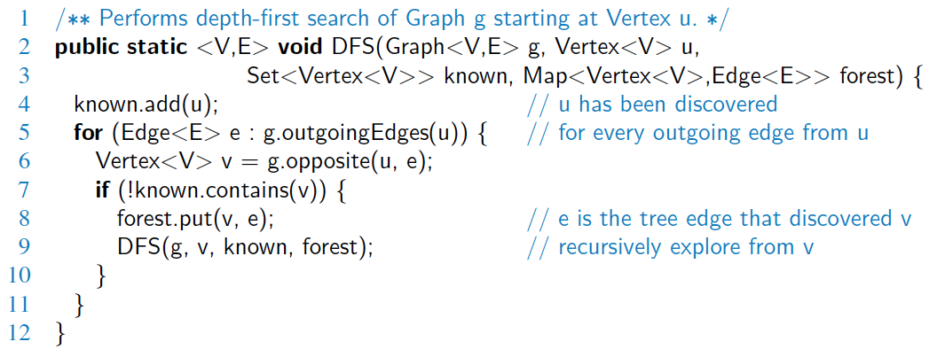
Java Implementation

Slide 9
Example
A
unexplored vertex
A
A
visited vertex
B
D
E
unexplored edge
discovery edge
C
back edge
A
A
B
D
E
B
D
E
C
C

Slide 10
Example (cont.)
A
A
B
D
E
B
D
E
C
C
A
A
B
D
E
B
D
E
C
C

Slide 11
DFS and Maze Traversal
The DFS algorithm is similar to a classic strategy for exploring a maze
We mark each intersection, corner and dead end (vertex) visited
We mark each corridor (edge ) traversed
We keep track of the path back to the entrance (start vertex) by means of a rope (recursion stack)

Slide 12
Properties of DFS
Property 1
DFS(G, v) visits all the vertices and edges in the connected component of v
Property 2
The discovery edges labeled by DFS(G, v) form a spanning tree of the connected component of v
A
B
D
E
C

Slide 13
Analysis of DFS
Setting/getting a vertex/edge label takes O(1) time
Each vertex is labeled twice
once as UNEXPLORED
once as VISITED
Each edge is labeled twice
once as UNEXPLORED
once as DISCOVERY or BACK
Method incidentEdges is called once for each vertex
DFS runs in O(n + m) time provided the graph is represented by the adjacency list structure
Recall that Σ_{v} deg(v) = 2m

Slide 14
Path Finding
We can specialize the DFS algorithm to find a path between two given vertices u and z using the template method pattern
We call DFS(G, u) with u as the start vertex
We use a stack S to keep track of the path between the start vertex and the current vertex
As soon as destination vertex z is encountered, we return the path as the contents of the stack
Algorithm pathDFS(G, v, z)
setLabel(v, VISITED)
S.push(v)
if v = z
return S.elements()
for all e ∈ G.incidentEdges(v)
if getLabel(e) = UNEXPLORED
w ← opposite(v,e)
if getLabel(w) = UNEXPLORED
setLabel(e, DISCOVERY)
S.push(e)
pathDFS(G, w, z)
S.pop(e)
else
setLabel(e, BACK)
S.pop(v)

Slide 15
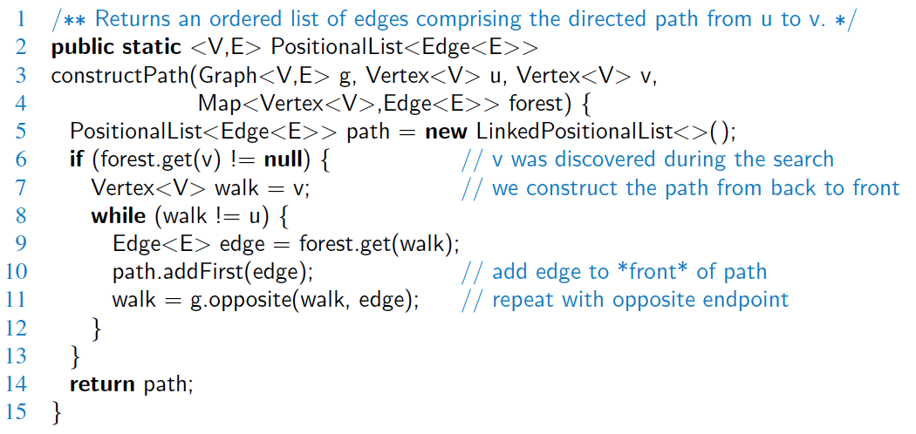
Path Finding in Java

Slide 16
Cycle Finding
We can specialize the DFS algorithm to find a simple cycle using the template method pattern
We use a stack S to keep track of the path between the start vertex and the current vertex
As soon as a back edge (v, w) is encountered, we return the cycle as the portion of the stack from the top to vertex w
Algorithm cycleDFS(G, v, z)
setLabel(v, VISITED)
S.push(v)
for all e ∈ G.incidentEdges(v)
if getLabel(e) = UNEXPLORED
w ← opposite(v,e)
S.push(e)
if getLabel(w) = UNEXPLORED
setLabel(e, DISCOVERY)
pathDFS(G, w, z)
S.pop(e)
else
T ← new empty stack
repeat
o ← S.pop()
T.push(o)
until o = w
return T.elements()
S.pop(v)

Slide 17
DFS for an Entire Graph
The algorithm uses a mechanism for setting and getting “labels” of vertices and edges
Algorithm DFS(G, v)
Input graph G and a start vertex v of G
Output labeling of the edges of G in the connected component of v as discovery edges and back edges
setLabel(v, VISITED)
for all e ∈ G.incidentEdges(v)
if getLabel(e) = UNEXPLORED
w ← opposite(v,e)
if getLabel(w) = UNEXPLORED
setLabel(e, DISCOVERY)
DFS(G, w)
else
setLabel(e, BACK)
Algorithm DFS(G)
Input graph G
Output labeling of the edges of G as discovery edges and back edges
for all u ∈ G.vertices()
setLabel(u, UNEXPLORED)
for all e ∈ G.edges()
setLabel(e, UNEXPLORED)
for all v ∈ G.vertices()
if getLabel(v) = UNEXPLORED
DFS(G, v)

Slide 18
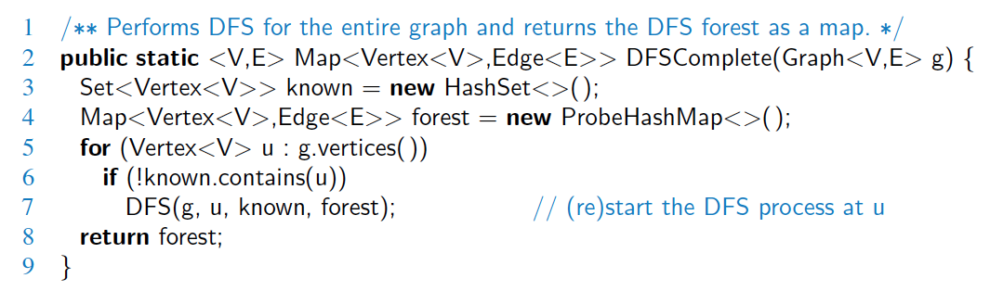
All Connected Components
Loop over all vertices, doing a DFS from each unvisted one.

